Slide 1

Parallel & Distributed Computing Lecture 3: General Parallelism Terms
Farhad M. Riaz
Farhad.Muhammad@numl.edu.pk
Department of Computer Science
NUML, Islamabad

Slide 2
Some General Parallel Terminology
Supercomputing / High Performance Computing (HPC)
Using the world's fastest and largest computers to solve large problems
Node
A standalone "computer in a box". Usually comprised of multiple CPUs/processors/cores, memory, network interfaces, etc. Nodes are networked together to comprise a supercomputer.
CPU / Socket / Processor / Core
In the past, a CPU (Central Processing Unit) was a singular execution component
Then, multiple CPUs were incorporated into a node
Then, individual CPUs were subdivided into multiple "cores", each being a unique execution unit
CPUs with multiple cores are sometimes called "sockets”
The result is a node with multiple CPUs, each containing multiple cores

Slide 4
Some General Parallel Terminology
Task
A logically discrete section of computational work. A task is typically a program or program-like set of instructions that is executed by a processor. A parallel program consists of multiple tasks running on multiple processors.
Pipelining
Breaking a task into steps performed by different processor units, with inputs streaming through, much like an assembly line; a type of parallel computing.
Shared Memory
From a strictly hardware point of view, describes a computer architecture where all processors have direct (usually bus based) access to common physical memory. In a programming sense, it describes a model where parallel tasks all have the same "picture" of memory and can directly address and access the same logical memory locations regardless of where the physical memory actually exists.

Slide 5
Some General Parallel Terminology
Symmetric Multi-Processor (SMP)
Shared memory hardware architecture where multiple processors share a single address space and have equal access to all resources.
Distributed Memory
In hardware, refers to network based memory access for physical memory that is not common. As a programming model, tasks can only logically "see" local machine memory and must use communications to access memory on other machines where other tasks are executing.
Communications
Parallel tasks typically need to exchange data. There are several ways this can be accomplished, such as through a shared memory bus or over a network, however the actual event of data exchange is commonly referred to as communications regardless of the method employed

Slide 6
Some General Parallel Terminology
Synchronization
The coordination of parallel tasks in real time, very often associated with communications.
Often implemented by establishing a synchronization point within an application where a task may not proceed further until another task(s) reaches the same or logically equivalent point.
Synchronization usually involves waiting by at least one task and can therefore cause a parallel application's wall clock execution time to increase.
Granularity
granularity is a qualitative measure of the ratio of computation to communication
Coarse: relatively large amounts of computational work are done between communication events
Fine: relatively small amounts of computational work are done between communication events
Observed Speedup
Observed speedup of a code which has been parallelized, defined as:
wall-clock time of serial execution
-----------------------------------
wall-clock time of parallel execution
One of the simplest and most widely used indicators for a parallel program's performance.

Slide 7
Some General Parallel Terminology
Parallel Overhead
The amount of time required to coordinate parallel tasks, as opposed to doing useful work. Parallel overhead can include factors such Task start-up time
Synchronizations
Data communications
Software overhead imposed by parallel languages, libraries, operating system, etc.
Task termination time
Massively Parallel
Refers to the hardware that comprises a given parallel system - having many processing elements. The meaning of "many" keeps increasing, but currently, the largest parallel computers are comprised of processing elements numbering in the hundreds of thousands
Embarrassingly Parallel
Solving many similar, but independent tasks simultaneously; little to no need for coordination between the tasks

Slide 8
Some General Parallel Terminology
Scalability
Refers to a parallel system's (hardware and/or software) ability to demonstrate a proportionate increase in parallel speedup with the addition of more resources. Factors that contribute to scalability include:
Hardware - particularly memory-CPU bandwidths and network communication properties
Application algorithm
Parallel overhead related
Characteristics of your specific application

Slide 9
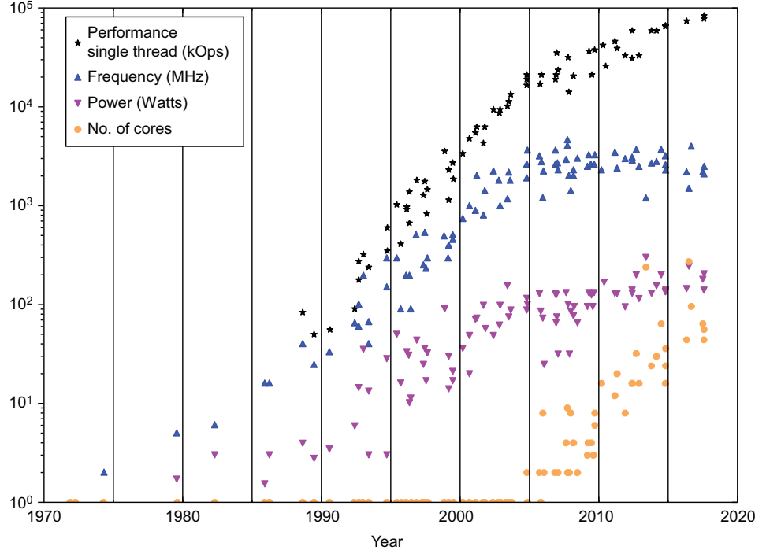
Why Parallel Computing is necessary?
Rise of multi-core computing machines
Under-utilization of resources
Hyperthreading, introduced by Intel
Notes:
This figure shows the single thread performance, CPU clock frequency (MHz), CPU power consumption (watts), and the number of CPU cores from 1970 to 2018. The parallel computing era begins about 2005, when the core count in CPU chips begins to rise, while the clock frequency and power consumption plateaus, yet performance steadily increases.
Hyperthreading: Having two instruction queues interleaving work to the hardware logic units allows a single physical core to appear as two cores to the operating system (OS).

Slide 10
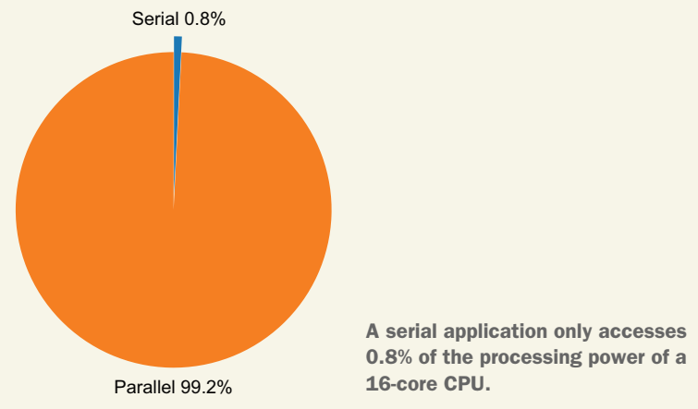
Example
Let’s take a 16-core CPU with hyperthreading and a 256 bit-wide vector unit, commonly found in home desktops. A serial program using a single core and no vectorization only uses 0.8% of the theoretical processing capability of this processor.
The calculation is
16 cores × 2 hyperthreads × (256 bit-wide vector unit)/(64-bit double) = 128-way parallelism where 1 serial path/128 parallel paths = .008 or 0.8%. The following figure shows that this is a small fraction of the total CPU processing power.

Slide 11
Benefits of Parallel Computing
Lesser execution time with multiple cores
Solve larger and complex problems
Energy efficient system
Cost reduction
Notes:
Energy efficient: With the emergence of parallel resources in handheld devices, parallelism can speed up applications. This allows the device to return to sleep mode sooner and permits the use of slower, but more parallel processors that consume less power. Thus, moving heavyweight multimedia applications to run on GPUs can have a more dramatic effect on energy efficiency while also resulting in vastly improved performance. The net result of employing parallelism reduces power consumption and extends battery life, which is a strong competitive advantage in this market niche. Another area where energy efficiency is important is with remote sensors, network devices, and operational field-deployed devices, such as remote weather stations. Often, without large power supplies, these devices must be able to function in small packages with few resources. Parallelism expands what can be done on these devices and offloads the work from the central computing system in a growing trend that is called edge compute. Moving the computation to the very edge of the network enables processing at the source of the data, condensing it into a smaller result set that can be more easily sent over the network.

Slide 12









FLOPS
Floating point operations per second
Measure of theoretical peak performance

Slide 13
FLOPS
Servers are the only computers that sometimes have more than one socket; for most home computers (desktop or
laptop), “sockets” will be 1.
Cores per socket depends on your CPU. It could be 2 (dual- core), 3, 4 (quad-core), 6 (hexa-core), or 8. There are some prototype CPUs with as many as 80 cores.
“Clock cycles per second” refers to the speed of your CPU. Most modern CPUs are rated in gigahertz. So 2 GHz would be 2,000,000,000 clock cycles per second.
The number of FLOPs per cycle also depends on the CPU. One of the fastest (home computer) CPUs is the Intel Core i7–970, capable of 4 double-precision or 8 single-precision floating-point operations per cycle.

Slide 14
Test
Intel Core i7–970 has 6 cores. If it is running at 3.46 GHz and can perform 8 floating point operations per second, calculate the theoretical compute power of this machine.

Slide 15
Example
Intel Core i7–970 has 6 cores. If it is running at
3.46 GHz, the formula would be:
1 (socket) * 6 (cores) * 3,460,000,000 (cycles per second) * 8 (single-precision FLOPs per second) = 166,080,000,000 single-precision FLOPs per second or 83,040,000,000 double- precision FLOPs per second.
109 GFLOPS.

Slide 16







Amdahl’s Law
Theoretical speedup calculations
where
S_{latency} is the theoretical speedup of the execution of the whole task;
s is the speedup of the part of the task that benefits from improved system resources;
p is the proportion of execution time that the part benefiting from improved resources originally occupied.

Slide 17
Example 1
If 30% of the execution time may be the subject of a speedup, p will be 0.3; if the improvement makes the affected part twice as fast, s will be 2. Amdahl's law states that the overall speedup of applying the improvement will be?

Slide 18
Example 2
Assume that we are given a serial task which is split into four consecutive parts, whose percentages of execution time are p1 = 0.11, p2 = 0.18, p3 = 0.23, and p4 = 0.48 respectively. Then we are told that the 1st part is not sped up, so s1 = 1, while the 2nd part is sped up 5 times, so s2 = 5, the 3rd part is sped up 20 times, so s3 = 20, and the 4th part is sped up 1.6 times, so s4 = 1.6. By using Amdahl's law, the overall speedup is?

Slide 19
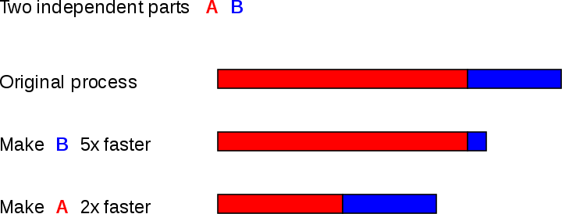

Amdahl’s Law

Slide 20
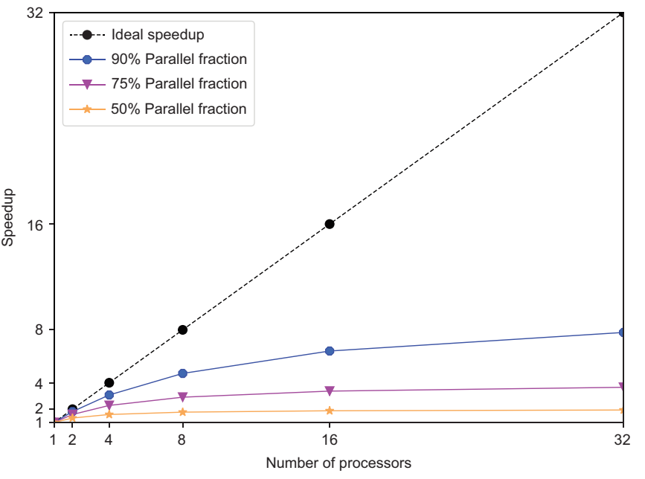


Slide 21
